Slide 1
Effects of COVID in New Zealand
By
Track Stars
(Zahid Khan, Perry li,
Jiani Wu, Kaishun Yang)
Notes:
Hello everyone, We are team TRACK STARS, and we decided to analyse the Effects of Covid in New Zealand.

Slide 2
Topics and Contents Covered
Total number of COVID Cases
Vaccines Administered
Crime Rate
Deathrate
Agriculture
GDP (Gross domestic product)
Notes:
As we all know that COVID has had a huge impact on almost every sector of our economy.
We did not have enough time or resources to cover each sector, so we choose 4 topics, which are :
Effects of COVID on CRIME RATE, Vaccination and DEATH RATE, on Agriculture And on NZ GDP

Slide 3


Data Sources
Covid Data
Ministry of Health NZ (Git Repo)
https://github.com/minhealthnz/nz-covid-data
Vaccination Data
Ministry of Health NZ (Git Repo)
https://github.com/minhealthnz/nz-covid-data
Crime Rate
New Zealand Police statistics
https://www.police.govt.nz/about-us/publications-statistics/data-and-statistics?nondesktop
Death Rate
Ministry of Health NZ (Git Repo)
https://github.com/minhealthnz/nz-covid-data
Notes:
The data collected for Covid Cases, Death rate and Vaccination is from Ministry of health Git-Repository.
Crime Rate statistics were collected from the NZ police website Which was another challenge.

Slide 4

Data Sources
Agriculture
Before Covid:
https://www.stats.govt.nz/information-releases/agricultural-production-statistics-june-2019-final/?fbclid=IwAR2WAR9QR33HcLXF7Nt-JAZZRukfgQiDJhFAukYjOz_HKqKOeQ8kJzxky3c
After Covid:
https://www.stats.govt.nz/information-releases/agricultural-production-statistics-year-to-june-2021-final/?fbclid=IwAR04a29AGmveWZyfI0V9i9yD-5OP68RAazrGrpmOWMw4GRZKpane8jcWjzA
GDP
https://www.stats.govt.nz/information-releases/gross-domestic-product-june-2022-quarter/?fbclid=IwAR1bfYeCwfOSBIp97SkhGlWFzReIxGYD5Q7Fl5jaCmCf3yLqgXgGKbgwjIw
Notes:
For Agriculture and GDP sector the data was collected from Stats NZ

Slide 5
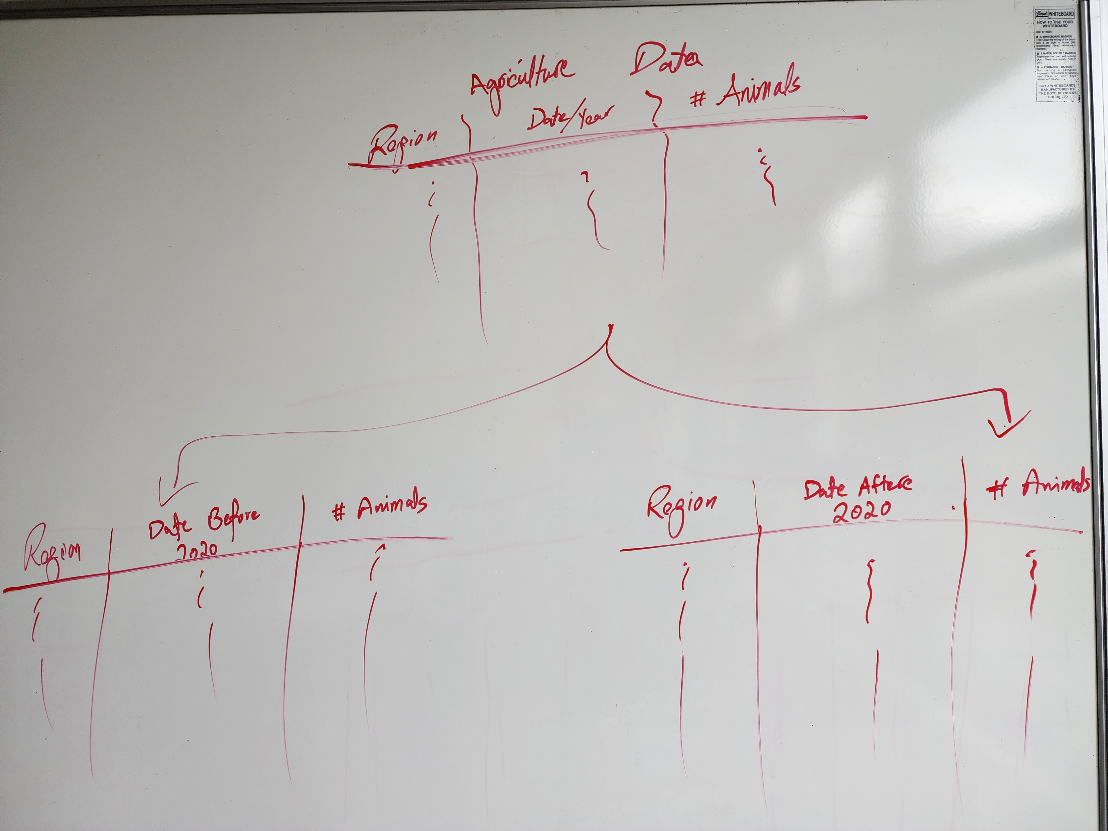
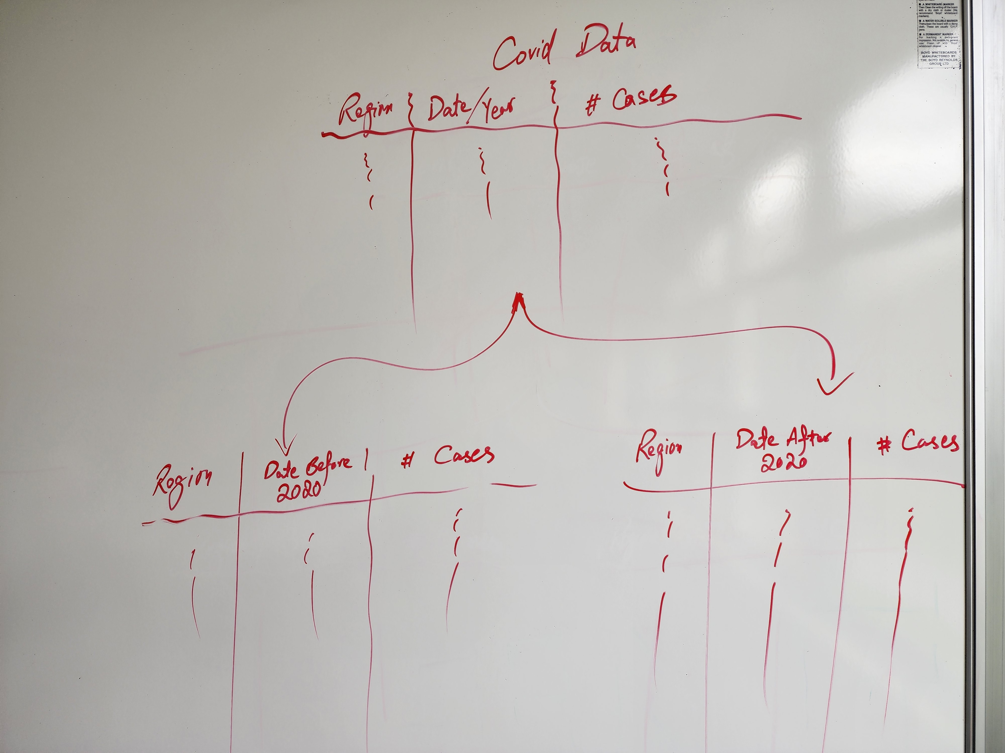
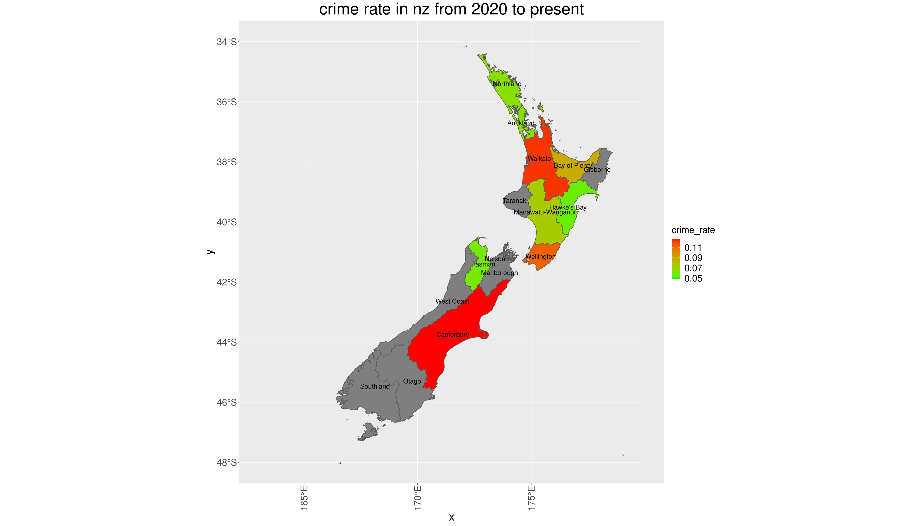
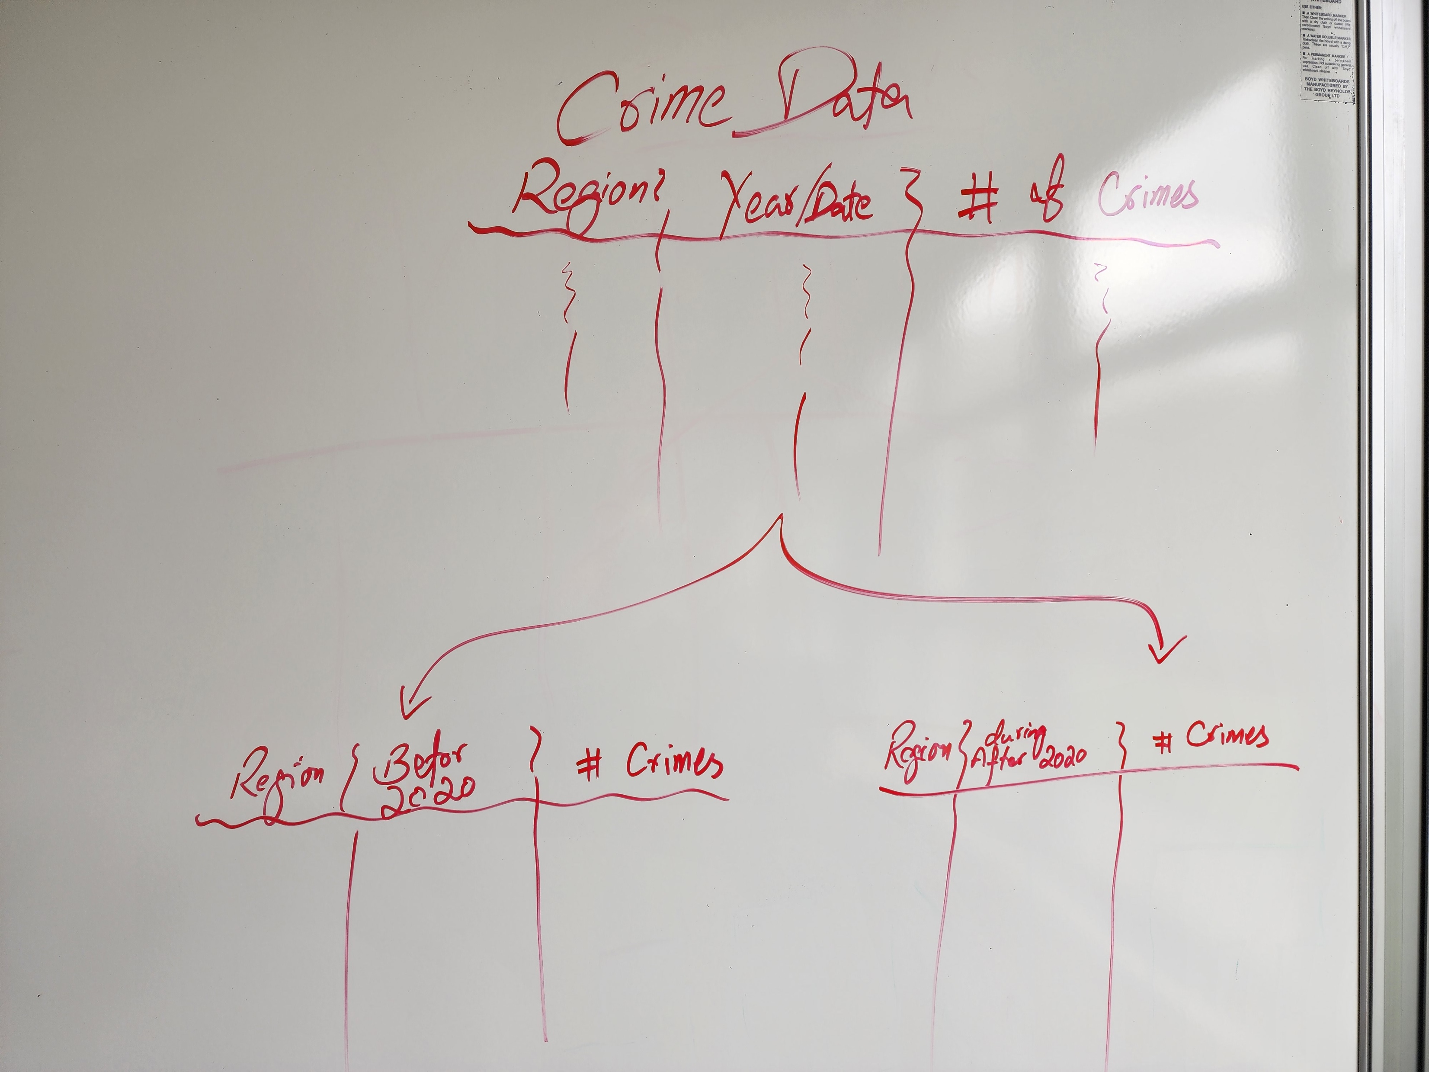
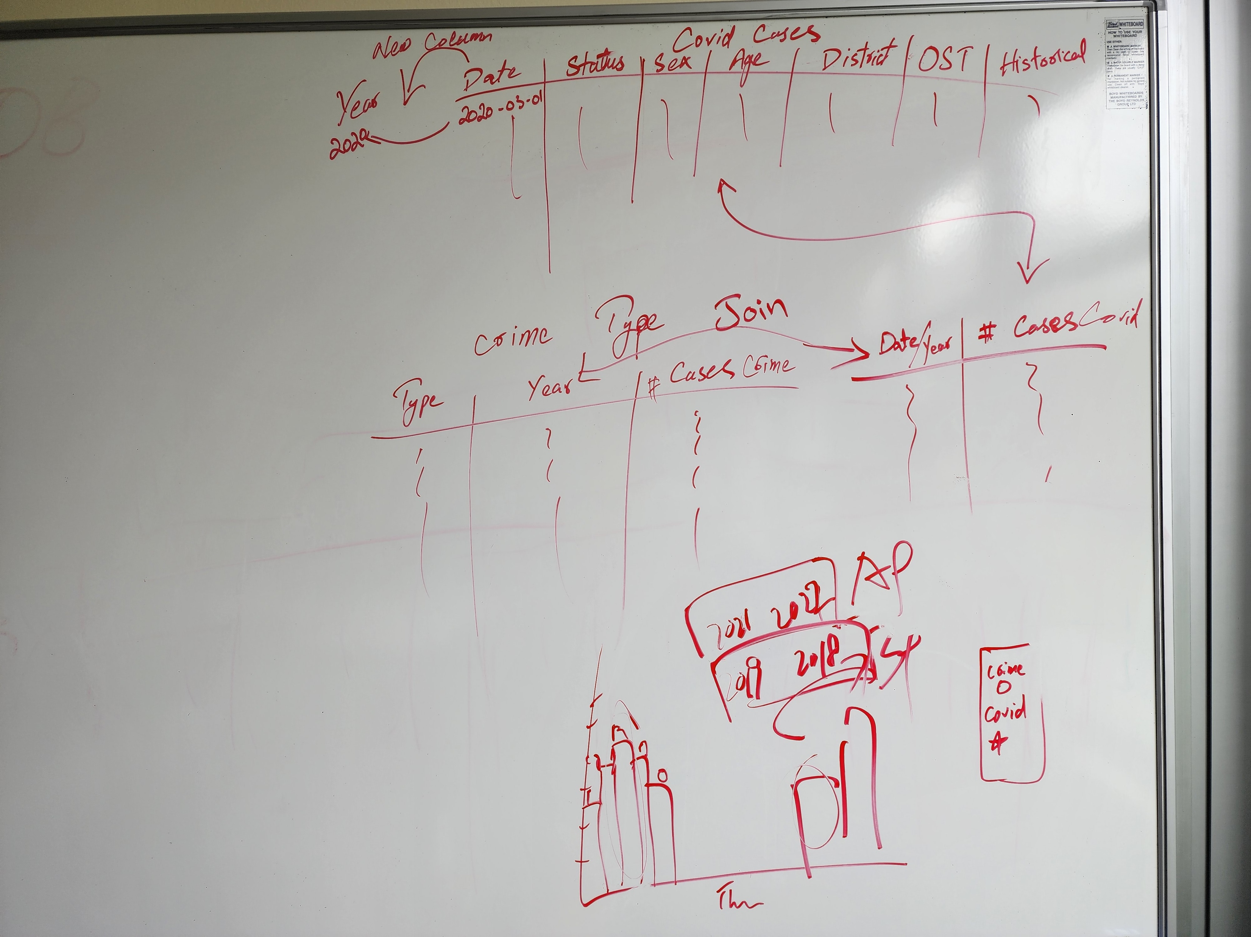
Planning
Notes:
The Major challenge we faced was to collect the CORRECT data from various resources.
there is a lot of data available on COVID but not much on how it affected different sectors.
After getting the data we faced even bigger problem, that our data had no common ground to join the datasets on and was different in date range and values.
Even the region boundary for DHB and Police Districts are different.
On top of that the regions for all the datasets were different from the GGPLOT NZ Map regions, which means THERE WAS LOTS OF CLEANING TO DO.

Slide 6
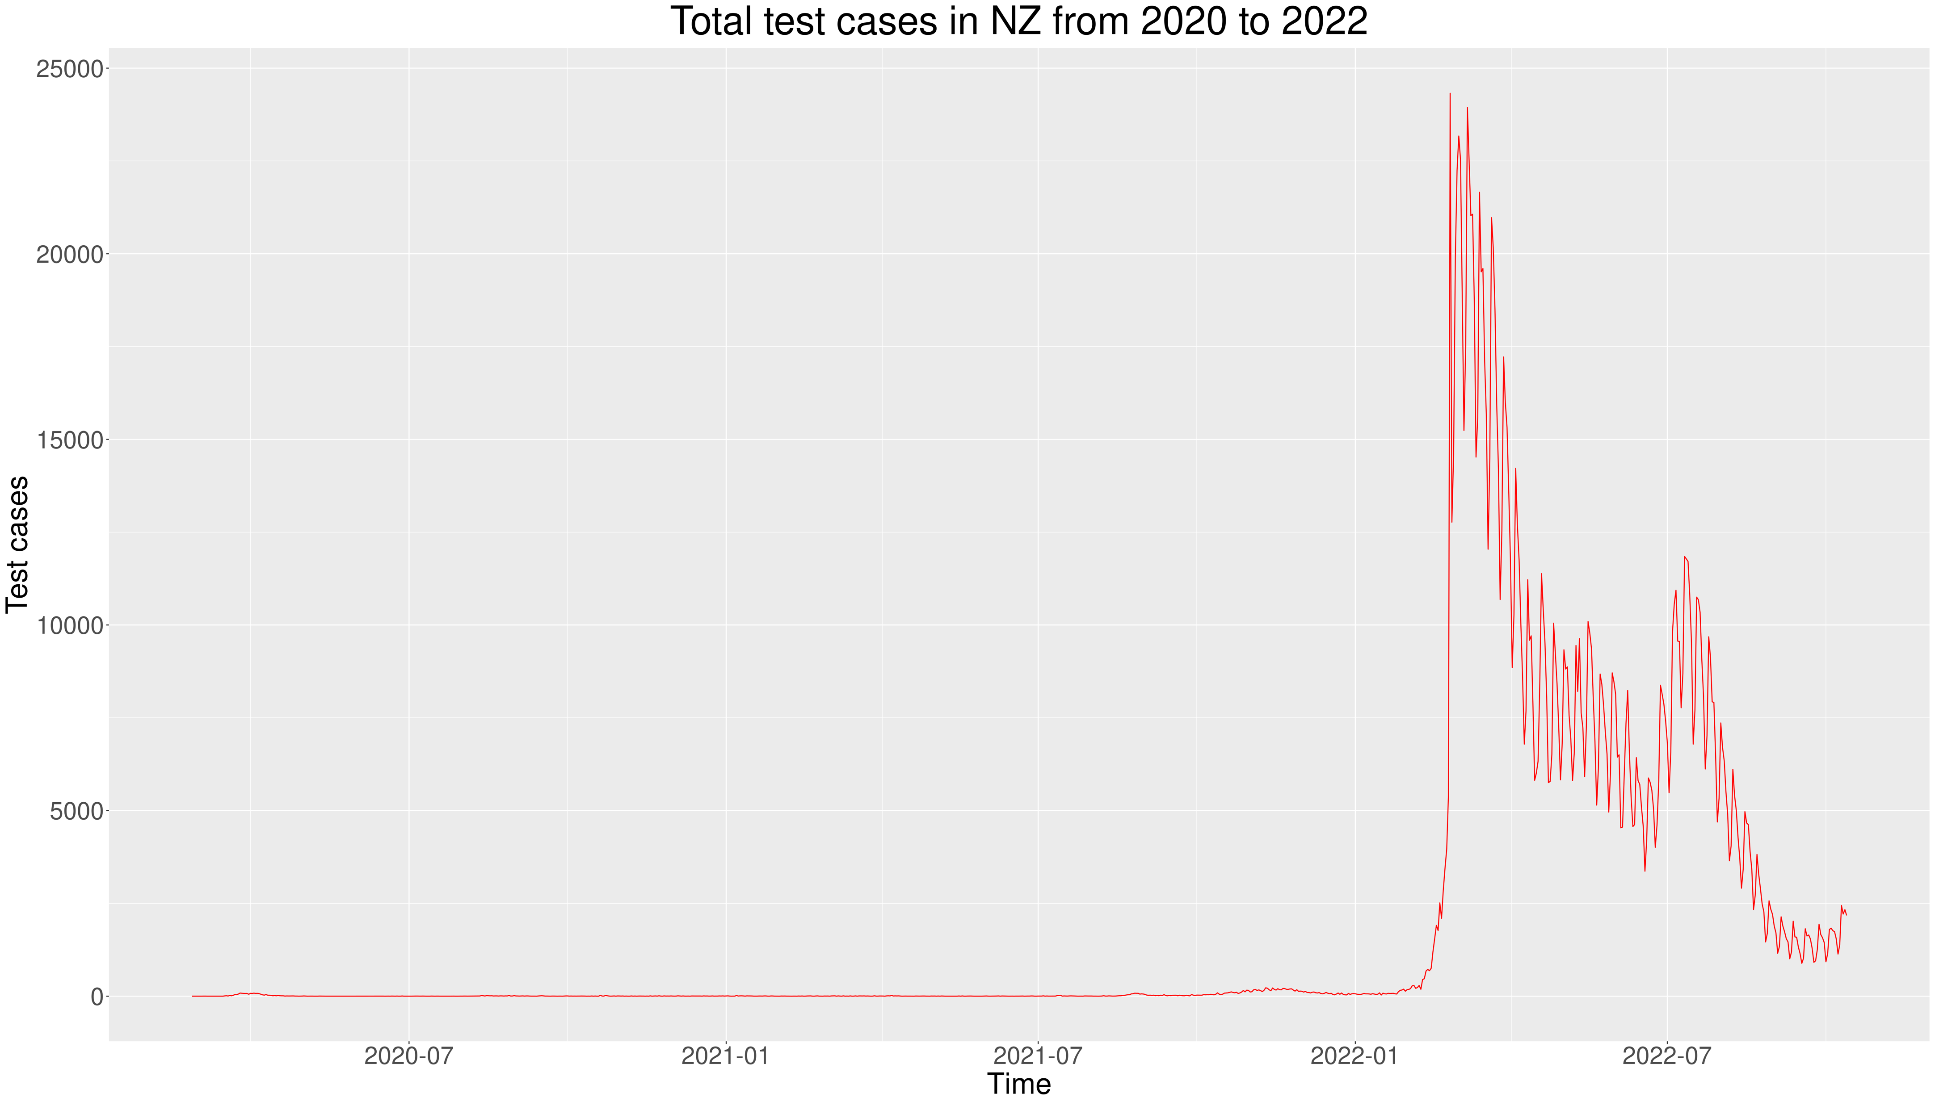
Covid Cases
Zahid Khan
Notes:
The graph on screen shows the Trend line for Covid Cases till August 2022,
We must say that lockdowns and restrictions were very beneficial, but in 2022 when Govt. decide to lift all the restrictions the number of cases increased dramatically.

Slide 7
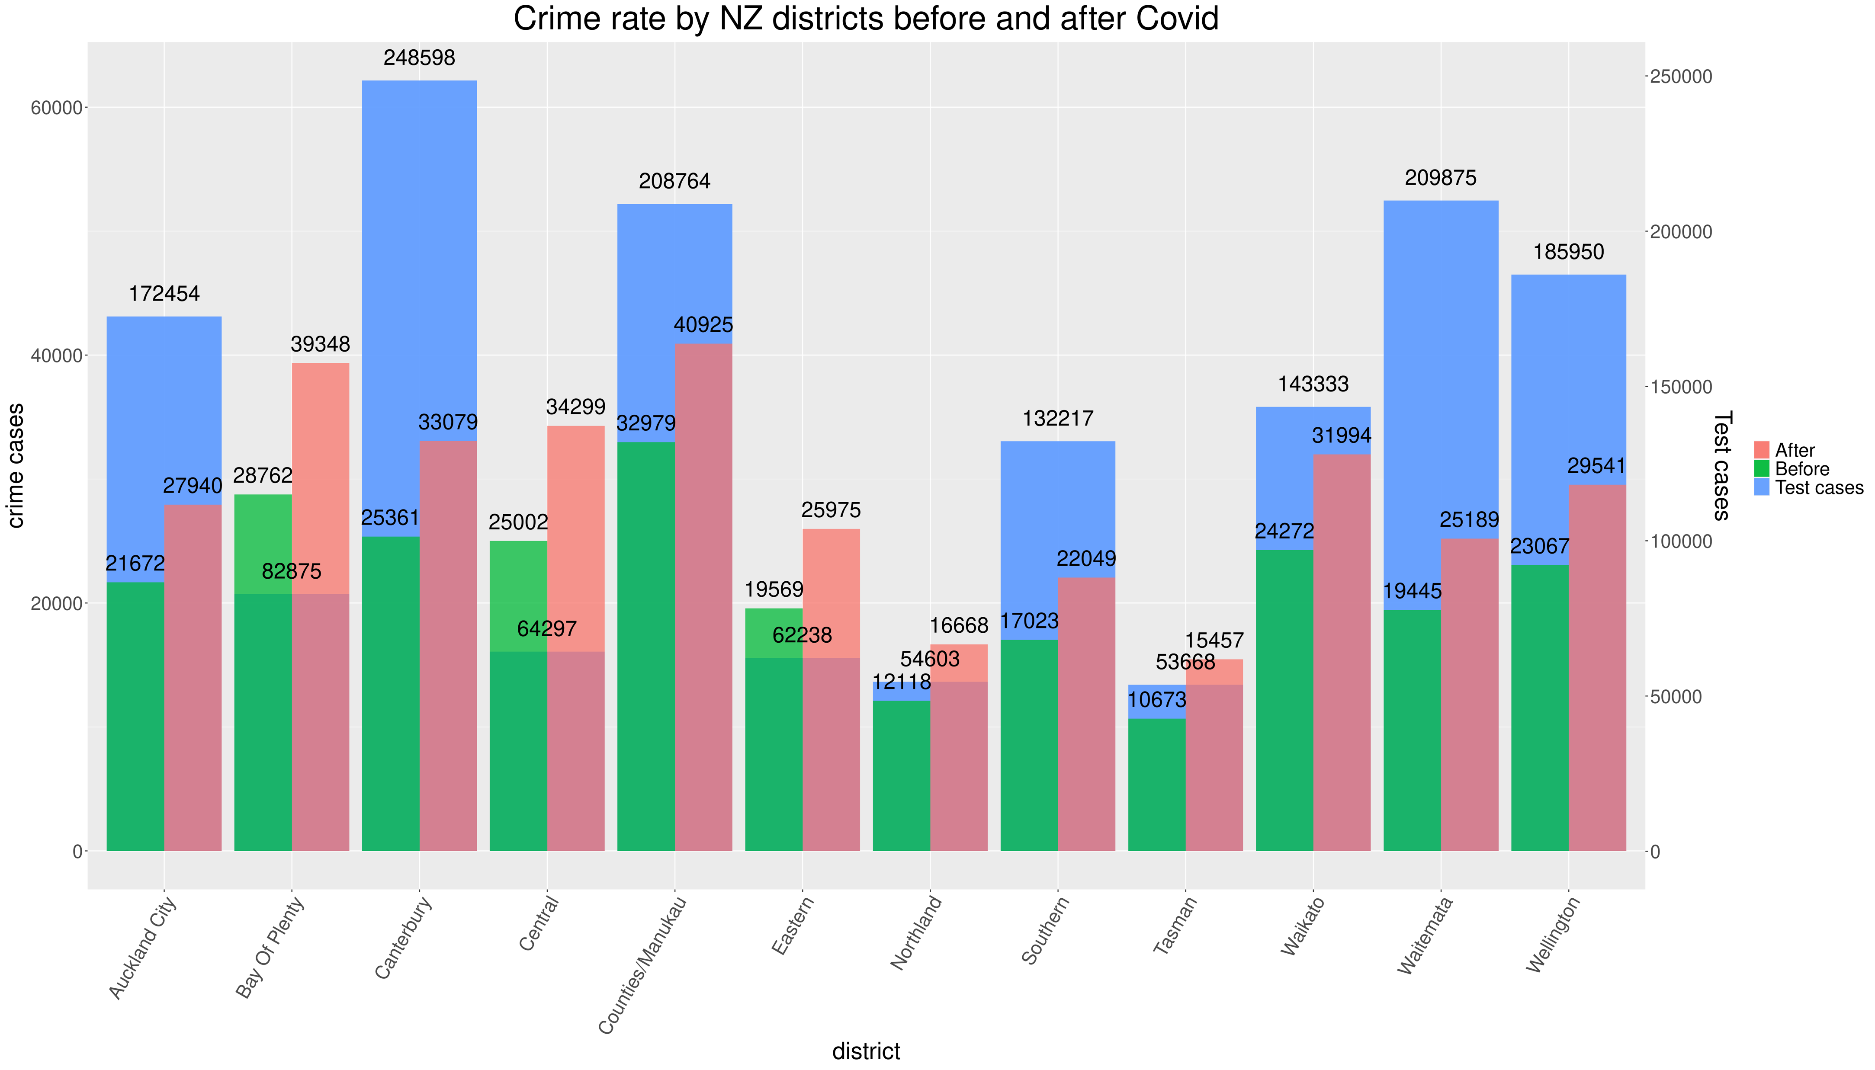
Crime Rate
Zahid Khan
Notes:
Now the biggest question “Effects of COVID on crime rate in New Zealand”.
This graph shows to total number of COVID cases per region in blue,
Crime rate before COVID is in green, and the period of data is 2 years before COVID.
AND
Crime rate During COVID is in RED.
As we can see clearly that CRIME-Rate during COVID increased in every region of the country.

Slide 8
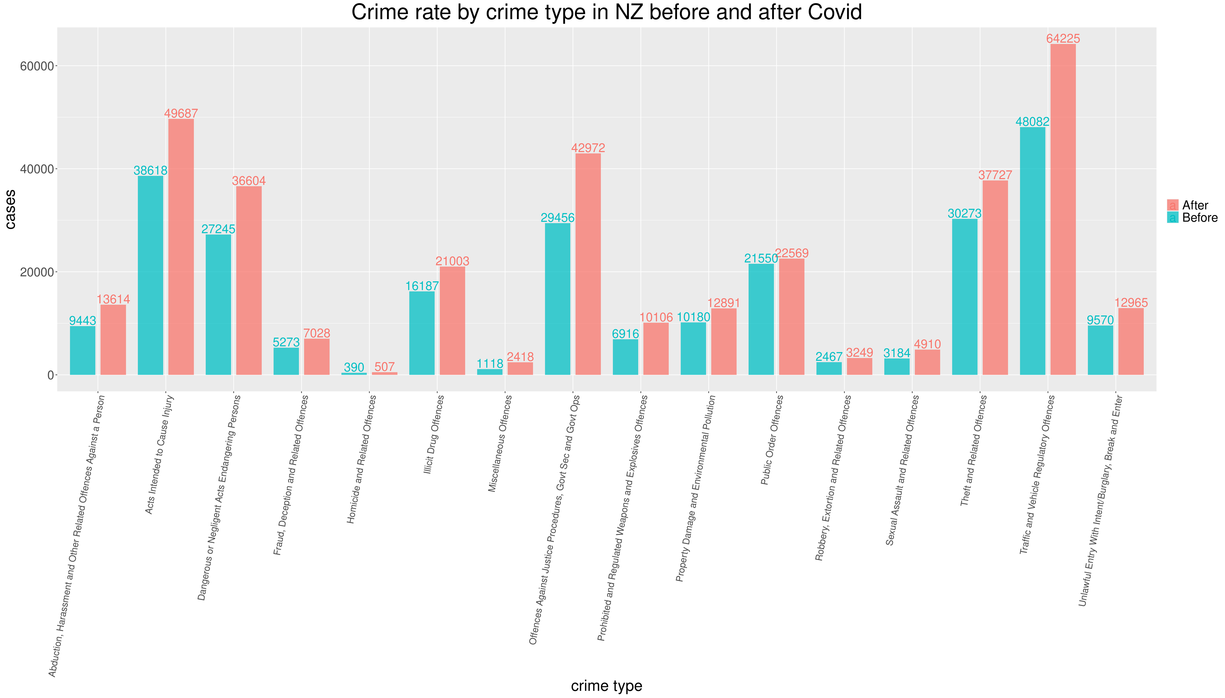
Crime Rate
Zahid Khan
Notes:
We decided to dig a little deeper to see what types of crimes are on rise.
As we can see from the graph, that there are 3 – 4 types of crimes that has seen a significant increases:
Dramatic increase can be seen in Theft, Offences Against Justice Procedures, Traffic Offences
I believe COVID has played a big role in all of this.

Slide 9
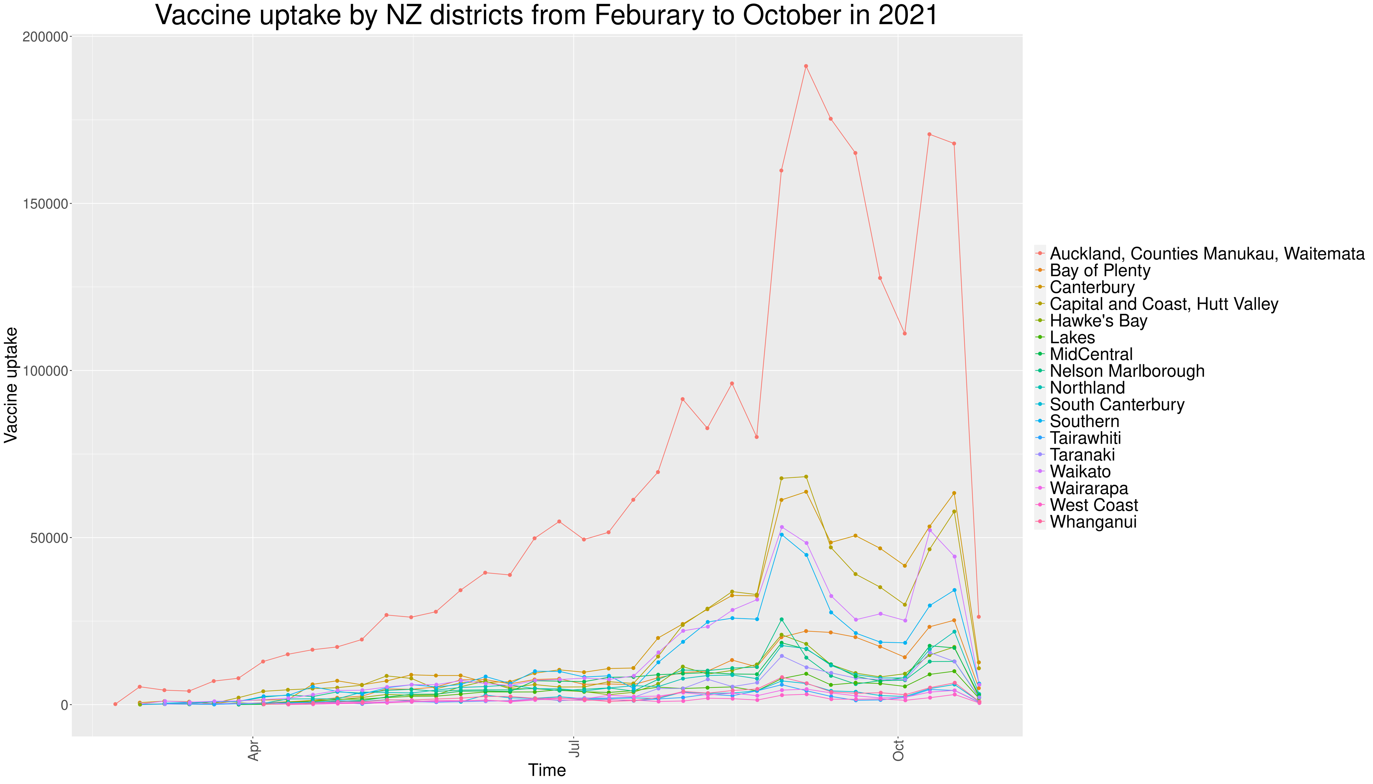
Vaccine Rate
Kaishun (Ted) Yang
Notes:
This section we are interested is to see if the the death rate was affected vaccine uptake rate, our assumption is that vaccine can directly alleviate covid impact on death rate, we gathered and reproduced the data into the two graphs that show the total number of vaccine uptake by regions. In this graph, it shows Auckland has an exceptionally high vaccine uptake number from beginning to the end, and the number for the rest of regions have risen up between July and October but they have very subtle difference before that.

Slide 10
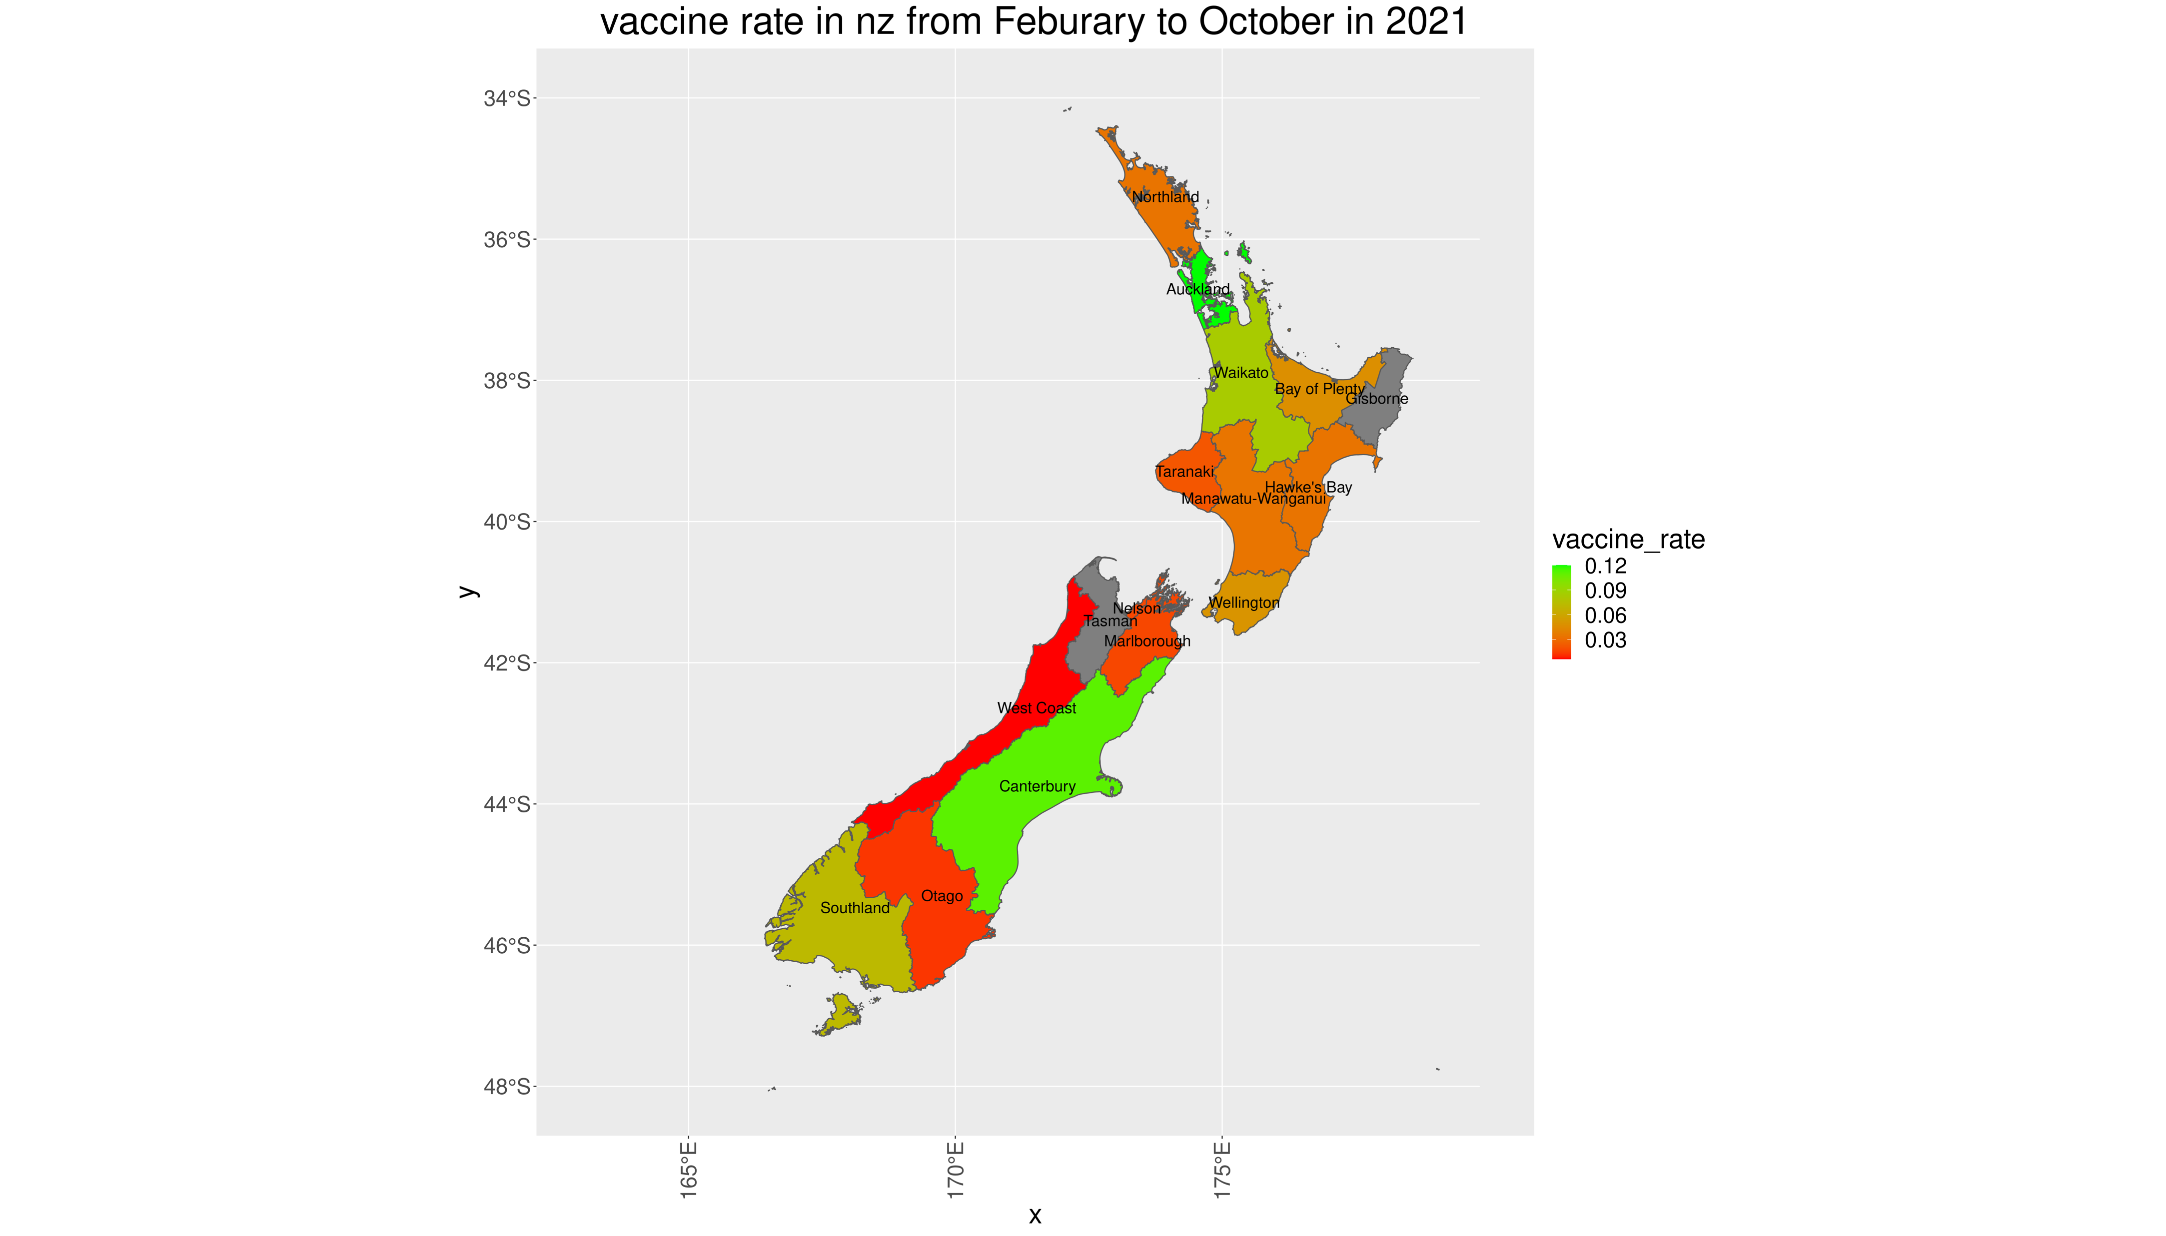
Vaccine Rate
Kaishun (Ted) Yang
Notes:
In this graph we shows the vaccine rate of each region with more visible measurement.

Slide 11
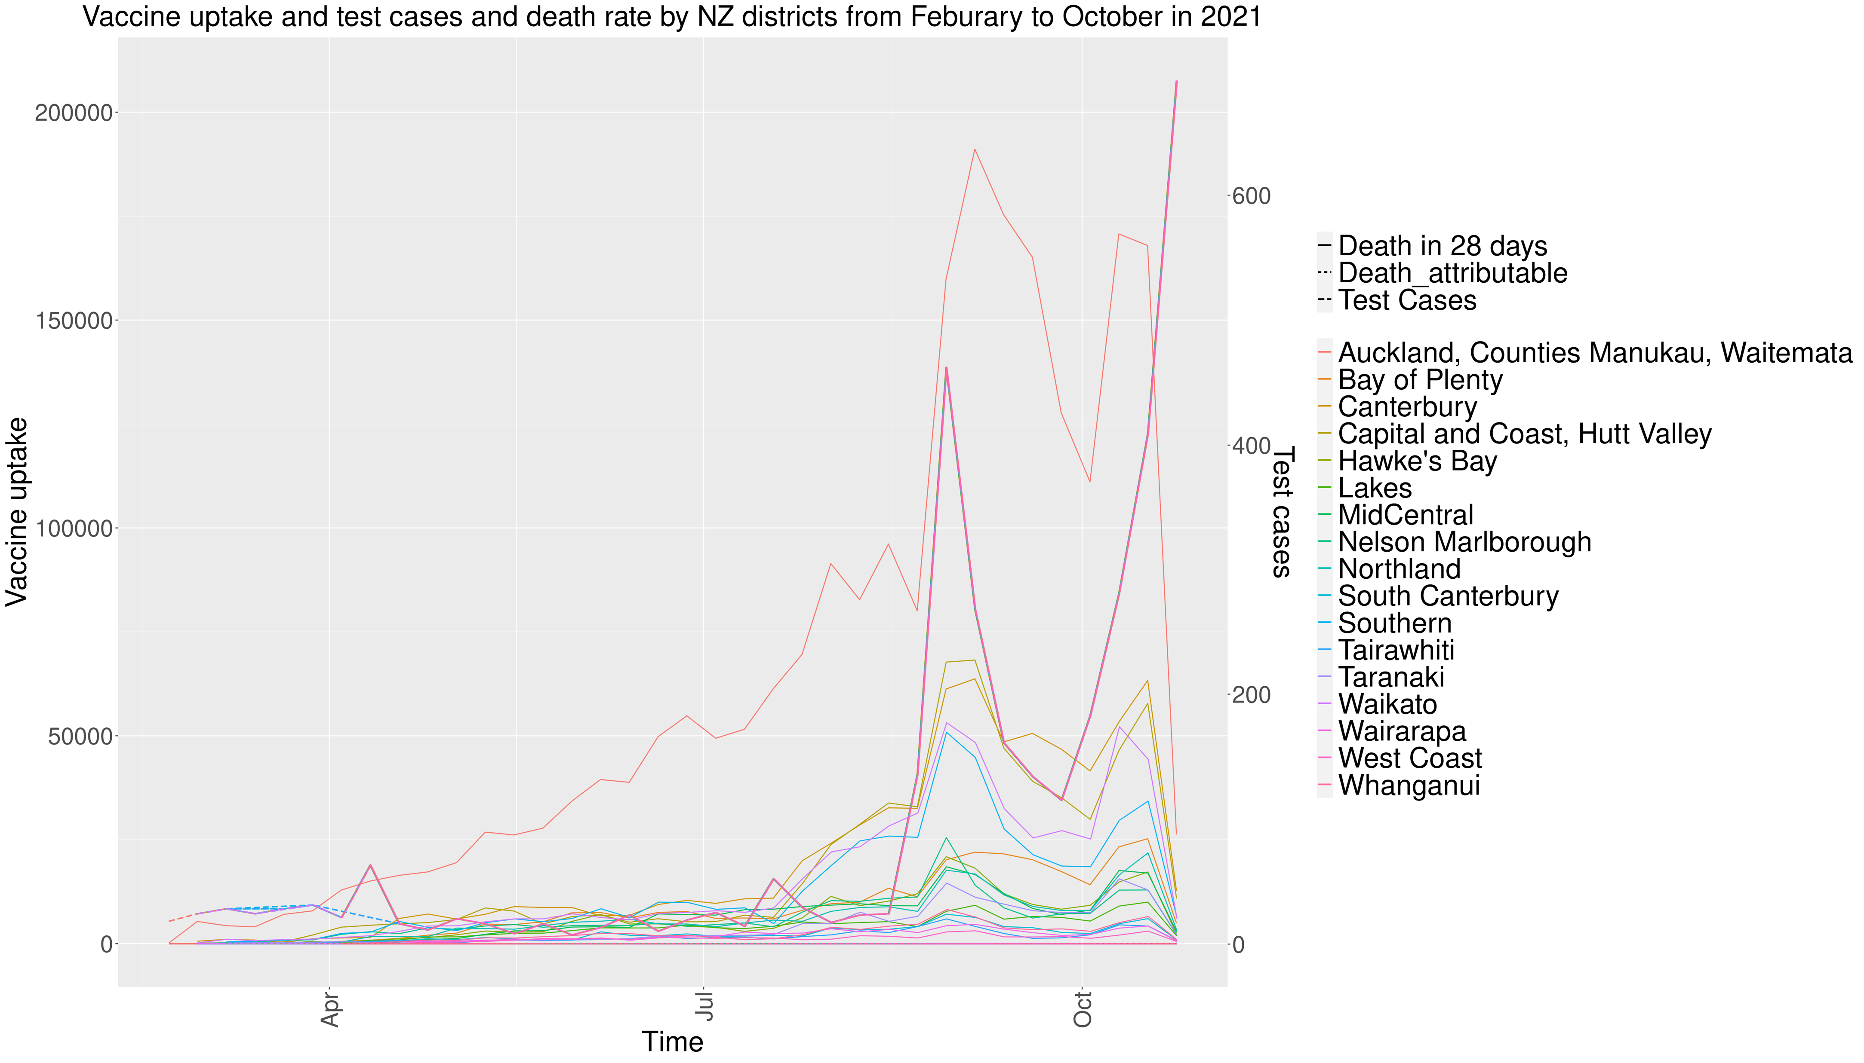
Death Rate
Kaishun (Ted) Yang
Notes:
As we can tell from this concluded graph that the death cases are extremely close to 0 shown at the very bottom of graph, and total test cases has been rising up along with Auckland vaccine number. which implies that the vaccine uptake rate have a strong connection to death rate that shows substantial success during the period, whereas the test cases keep increasing yet vaccine rate went down.

Slide 12
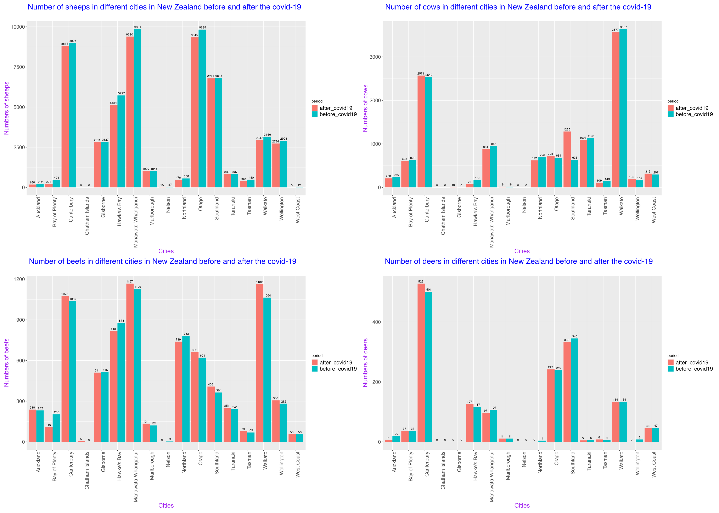
Agriculture
Jiani (Norie) Wu
Notes:
1.From the sheep comparison graph, every cities in NZ has a slight reduction about numbered of sheep after covid,
2.From the cow's comparison graph, cities in NZ there are 8 cities experienced a decreasing in number of cows after covid
3.From the beef comparison graph , the quantities of beefs keep raising in 80 percentage of cities in NZ , so a little influence on the number of beef cattle in NZ after the outbreak
4. Only 5 cities are influenced into a reducing trends
Overall, from my data , this are a small bad impact on the number of the livestock before and after covid-19 , only sheep quantities got little reduction on every city

Slide 13
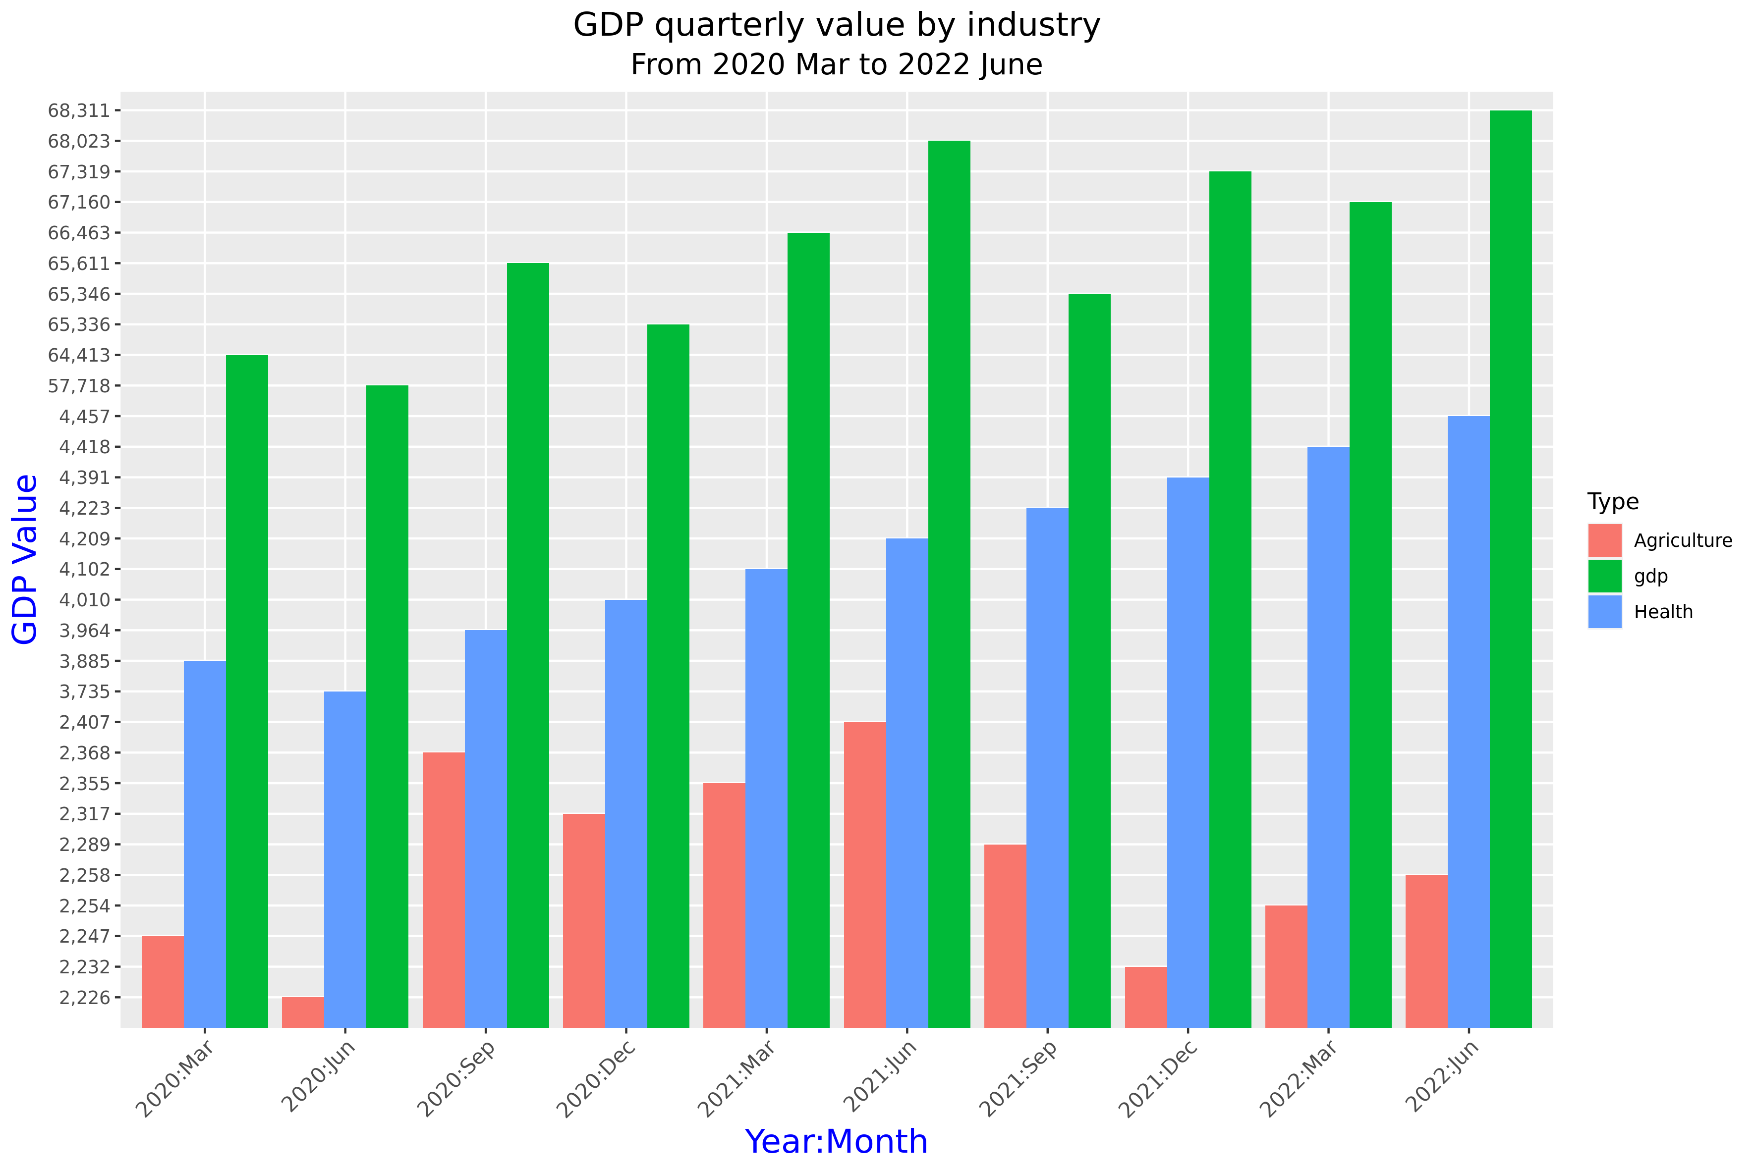
GDP
Pei (Perry) Li
Notes:
I used table for quarterly changes in GDP, from January 1987 to June 2022. In order to observe the impact of covid-19 on GDP, I intercepted data from March 2020 to June 2022.
As my teammates analysed the impact of covid-19 on agriculture and healthcare, I also compared GDP changes in these industry.
As we can see in the graph, health GDP shows a continuous upward trend. Agricultural GDP saw a huge reduction in the first few months of covid-19, which coincided with the start of New Zealand's lockdown After the end of the lockdown in September 2020, agricultural GDP started to grow up until the lockdown started again in August 2021.

Slide 14
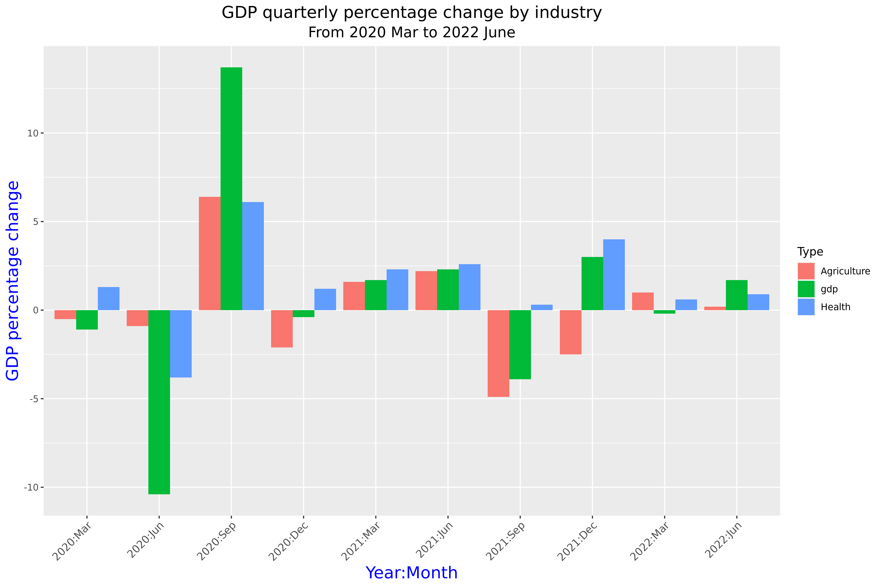
GDP
Pei (Perry) Li
Notes:
The second graph shows the quarterly percentage change in GDP. As we can see in the graph, from March to July 2020, GDP decreased significantly. During this time, the virus was raging all over the world, and New Zealand went into lockdown.
In September 2020, after the lockdown ended, there was a significant increase in GDP.
In September 2021, the number of covid-19 cases were rising again, and New Zealand went into a second lockdown. Both total and agricultural GDP declining, until in December 2021. Except of health GDP, which stayed positive through out the pandemic.

Slide 15
Conclusion
Covid has hugely influenced every sector in New Zealand
Crime Rate has gone up
NZ Economy has suffered
NZ Health has suffered
Very little growth in Agriculture
Notes:
We do not think there is a direct relation between number of case and crime rate per region,
Death-rete in NZ was very low compared to other countries, so it very hard to conclude that vaccination was effective.
COVID had a very influence on agriculture and GDP.
So, as we expected, COVID hugely influenced almost every sector in NZ.

Slide 16
Q&A
Add New Zealand Map Here…

Slide 17
Thank You
Honourable Mentions:
Teaching Team
Tutoring Team
Classmates
Thank you for your help, support and exchange of ideas through out the course.

